Slide 1
Replication
Lecture 8

Slide 2
Why do we do Replication?
To keep data geographically close to users.
To allow the system to continue working even if some parts of the system have failed.
To scale out the number of nodes that can serve READ queries.

Slide 3
Leader-based Replication
Two servers play “master” and “slave” roles.
Clients send operations (both READ and WRITE) to Leader.
Leader forwards WRITE operations to one or more followers.
Finally, leader replies to client.

Slide 4
Challenges
Non-deterministic operations.
No network partition—if leader cannot reach to followers, then the data will be inconsistent.
State transfer between leader and followers.
How to bring up a new follower after existing follower becomes leader.

Slide 5
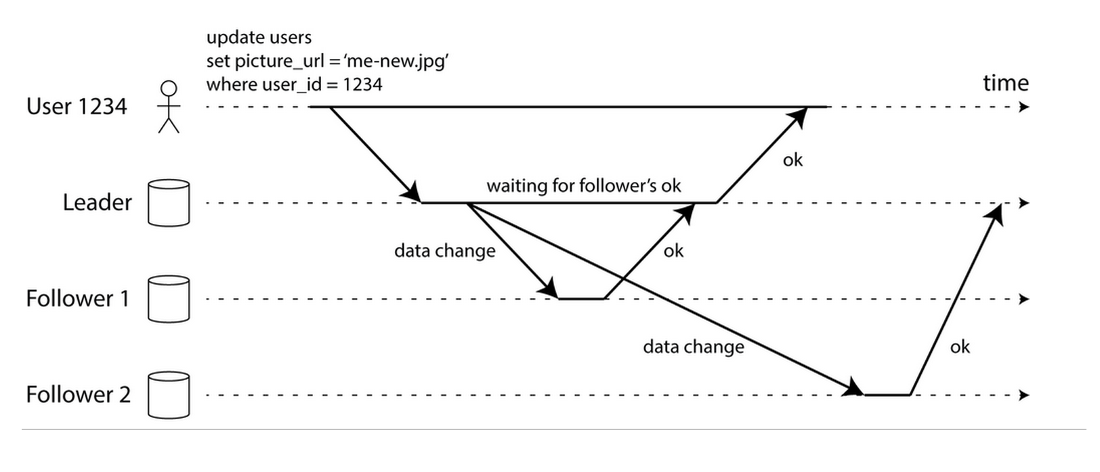
Sync vs. Async Replication

Slide 6
Monotonic reads
If a process has seen a particular value (version 3) for the object, any subsequence accesses will never return any previous values (version: 1 and 2)

Slide 7
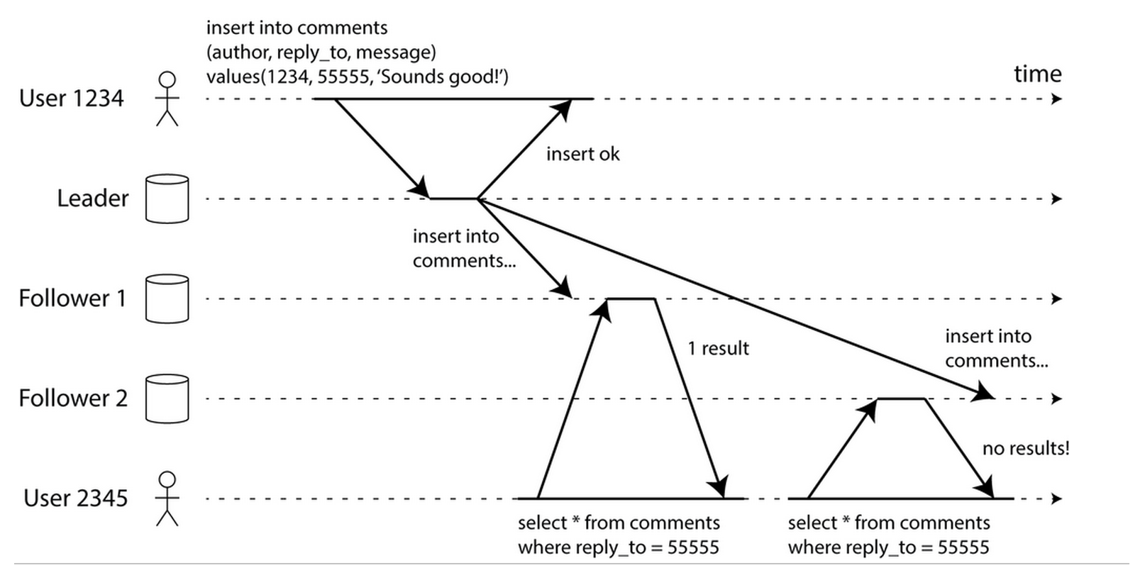
Monotonic reads

Slide 8
What is hashing?
Hashing is a process that maps data of a variable length to data of a fixed length.
The values returned by a hash function are called hashes, hash values, hash codes, hash sums, or checksums.

Slide 9
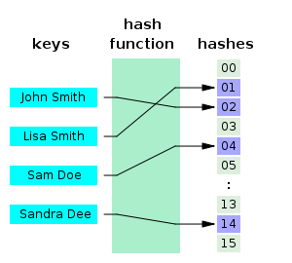
How hashing works?

Slide 10
Hashing uniformly distributed data
If the keys are fixed-length strings (E.g. phone numbers or user ids), then a hash function needs to map roughly the same number of keys to each hash value.
A common way of load balancing across n cache nodes is to put object o in cache node number hash(o) mod n.

Slide 11
Limitation of Naïve Hashing for load-balancing
When you add or remove from cache nodes, every object needs to hash to a new location.
This can be catastrophic since the originating content servers are swamped with requests from the cache machines.

Slide 12
Consistent Hashing (CH)

Slide 13
Why should you care about Consistent Hashing?
Suppose you have a collection of N cache machines.
Regular hashing can give you to load balance across them by putting object “o” in cache machine number - hash(o) mod N.
What if N changes by adding or removing cache machines for whatever reason?

Slide 14
What we want is…
You want to load balance multiple nodes based on the unique hash generated from the data storing in the DBs/Caches.
When a cache machine was added, it took its fair share of objects from all the other machines.
When a cache machine was removed, its objects were shared between the remaining machines.

Slide 15
What is Consistent Hashing?
Hash both objects and caches using the same hash function to map the cache to an interval.
When the cache is removed, its interval is taken over by a cache with an adjacent interval while the other caches remain unchanged.

Slide 16
What is Consistent Hashing?
Consistent hashing is a special kind of hashing.
When a hash table is resized and consistent hashing is used, only K/n keys need to be remapped on average, where K is the number of keys, and n is the number of slots.

Slide 17
How Consistent Hashing works
Define a hash ring:
From [0] to [M-1], where M = 2^32 for 32-int
Hash each node and assign into a range around the ring:
hash(node-0) % M => node_0_index
hash(node-1) % M => node_1_index
hash(node-2) % M => node_2_index
Hash data key and find the nearest node by clockwise direction.
hash(Foo) => Foo_index
Store ‘Foo’ in the closet node by index value. (E.g. ‘Foo’ index is closed to node_1_index)
Load factor is 1 / N.

Slide 18
Key distribution around the ring
Node-2
Node-0
K1
K3
Node-1
K2

Slide 19
Removing a node from the cluster (continuum)
K3
Node-2
Node-0
K1
Node-1
K2

Slide 20
Removing a node from the cluster (continuum)
K3
Node-2
Node-0
K1
K2
Node-1
When Node-1 crashes, ownership of K2 transferred to Node-2.

Slide 21
Removing a node from the cluster with Replication
K3
K3
Node-2
Node-0
K1
K2
Node-1
K2
K1
When Node-1 crashes, ownership of K2 transferred to Node-2. Replication => R = 2

Slide 22
Removing a node from the cluster with Replication
K3
K2
K2
Node-2
Node-0
K3
K1
K1
Node-1
When Node-1 crashes, ownership of K2 transferred to Node-2. Replication => R = 2

Slide 23
Adding a new node to the cluster
K4
Node-3
Node-0
K1
Node-2
Node-1
K3
K2
When Node-1 crashes, ownership of K2 transferred to Node-2.

Slide 24
Adding a node to the cluster with Replication
K4
K4
K3
Node-3
Node-0
K1
Node-2
Node-1
K3
K1
K2
K2
Replication => R = 2

Slide 25
Consistent Hashing with Virtual Nodes
In general, the distribution of keys can be irregular -- one machine has many keys and the other does not.
Instead of mapping machine number to a single point on the circle, map it to the multiple points (“replicas”).
Adding these replicas not only increases the uniformity with which key-value pairs are mapped to machines, but also a smaller number of keys are redistributed to that machine in the case of cluster size adjustment.

Slide 26
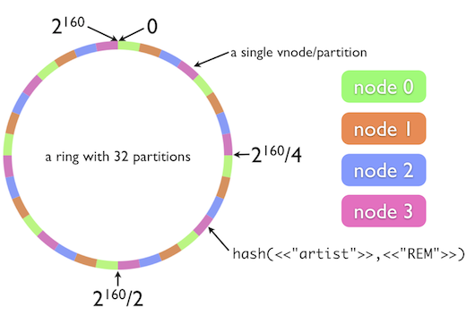
Virtual Nodes
Virtual node 0 and 1 are mapped to physical node 0.
Virtual node 2 and 3 are mapped to physical node 1.

Slide 27
Rendezvous (HRW) Hashing

Slide 28
Rendezvous (HRW) Hashing
Rendezvous hashing uses Highest Random Weight (HRW) to distribute objects uniformly over all nodes.
Minimal disruption: only objects mapping to the removed node may need to reassign to the other nodes.

Slide 29

How to compute Weight for object?

Slide 30
How to compute Weight for object?

Slide 31
Advantages of HRW over CH
Load balancing:
Since the hash function is randomizing, loads are uniform across the nodes.
Node capacity: different capacities--by storage size or data size—can be represented in the node list. So, hotspotting can be easily fixed.

Slide 32
CH/HRW => for data sharding and load balancing.
W = (key, node1) => host0 x 1(20%)
W = (key, node2) => host0 x 1(20% )
W = (key, node3) => host1 x 1(20%)
W = (request id, node4) => host1 x 1(40%) # Hotspot for load balancing
#
W = (key, node1) => host0 x 2(20%)
W = (key, node2) => host0 x 2(20%)
W = (key, node3) => host0 x 2(30%)
W = (key, node3) => host1 x 1(30%)

Slide 33
Advantages of HRW over CH
Minimal Disruption:
When a node is removed, only the keys mapped to that node need to be remapped .
Whereas in the consistent hashing (CH), K/n keys need to be remapped.

Slide 34
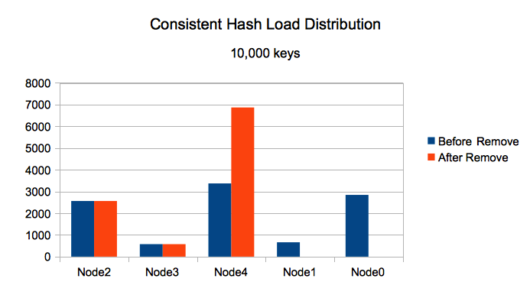
Consistent Hash (CH) Load Distribution
src: https://github.com/clohfink/RendezvousHash

Slide 35
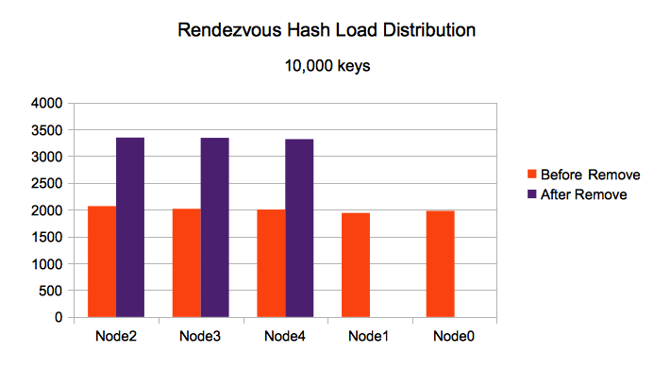
Rendezvous (HRW) Hash Load Distribution
src: https://github.com/clohfink/RendezvousHash

